Slide 1

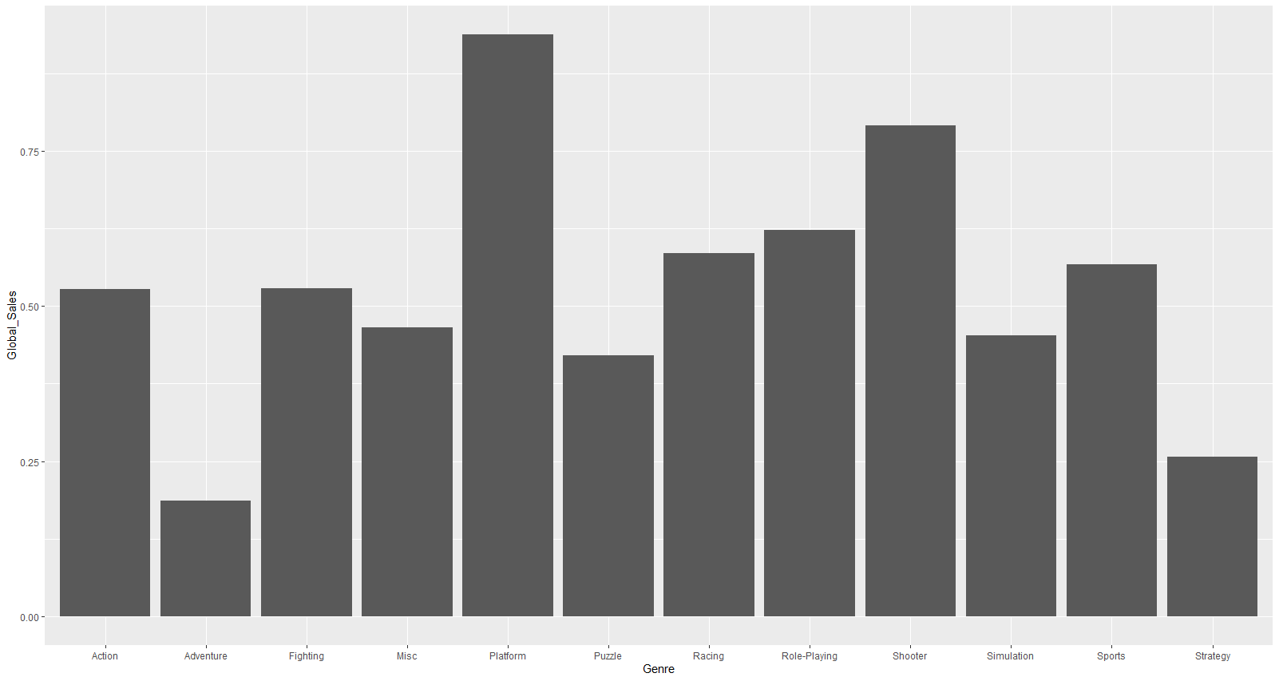
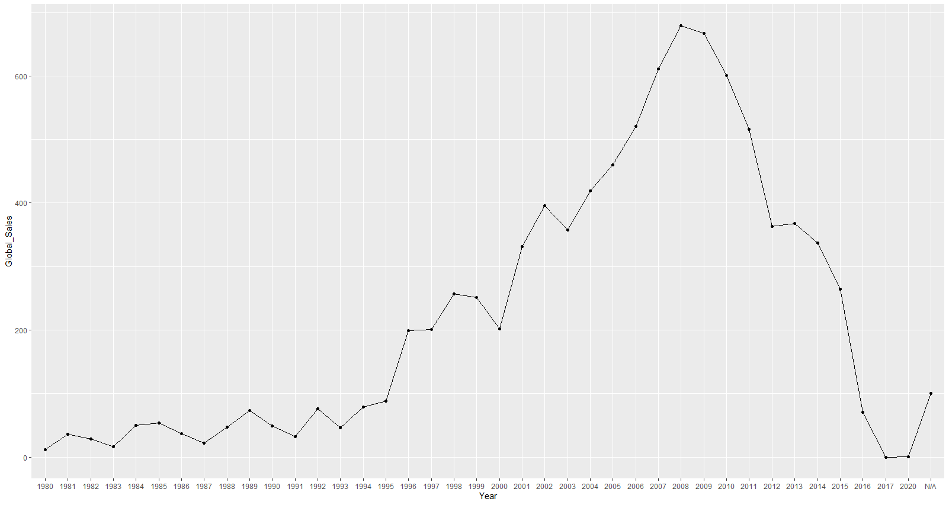
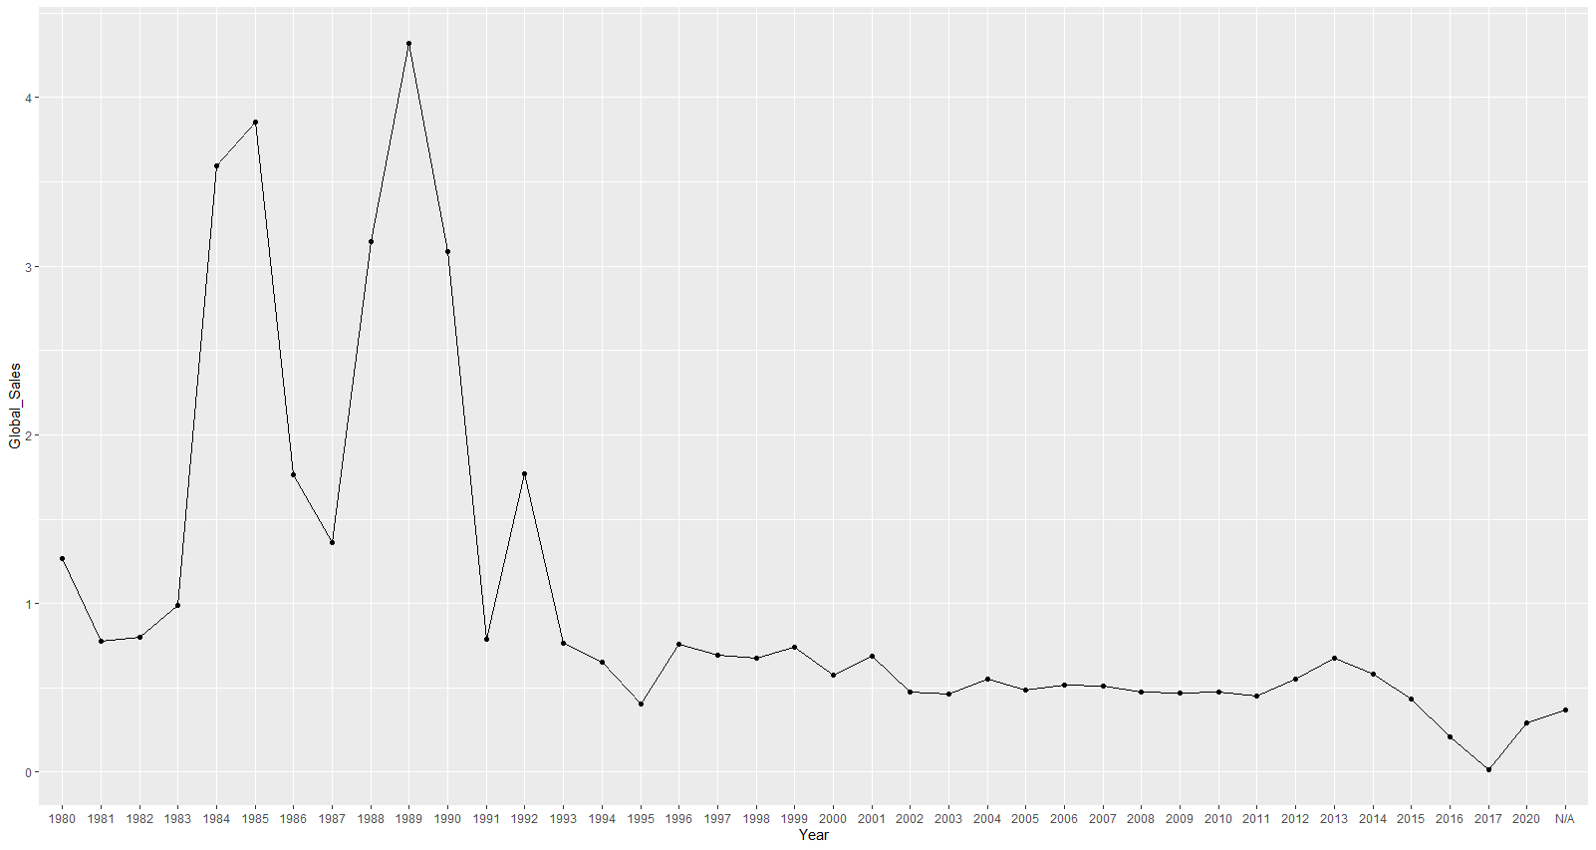
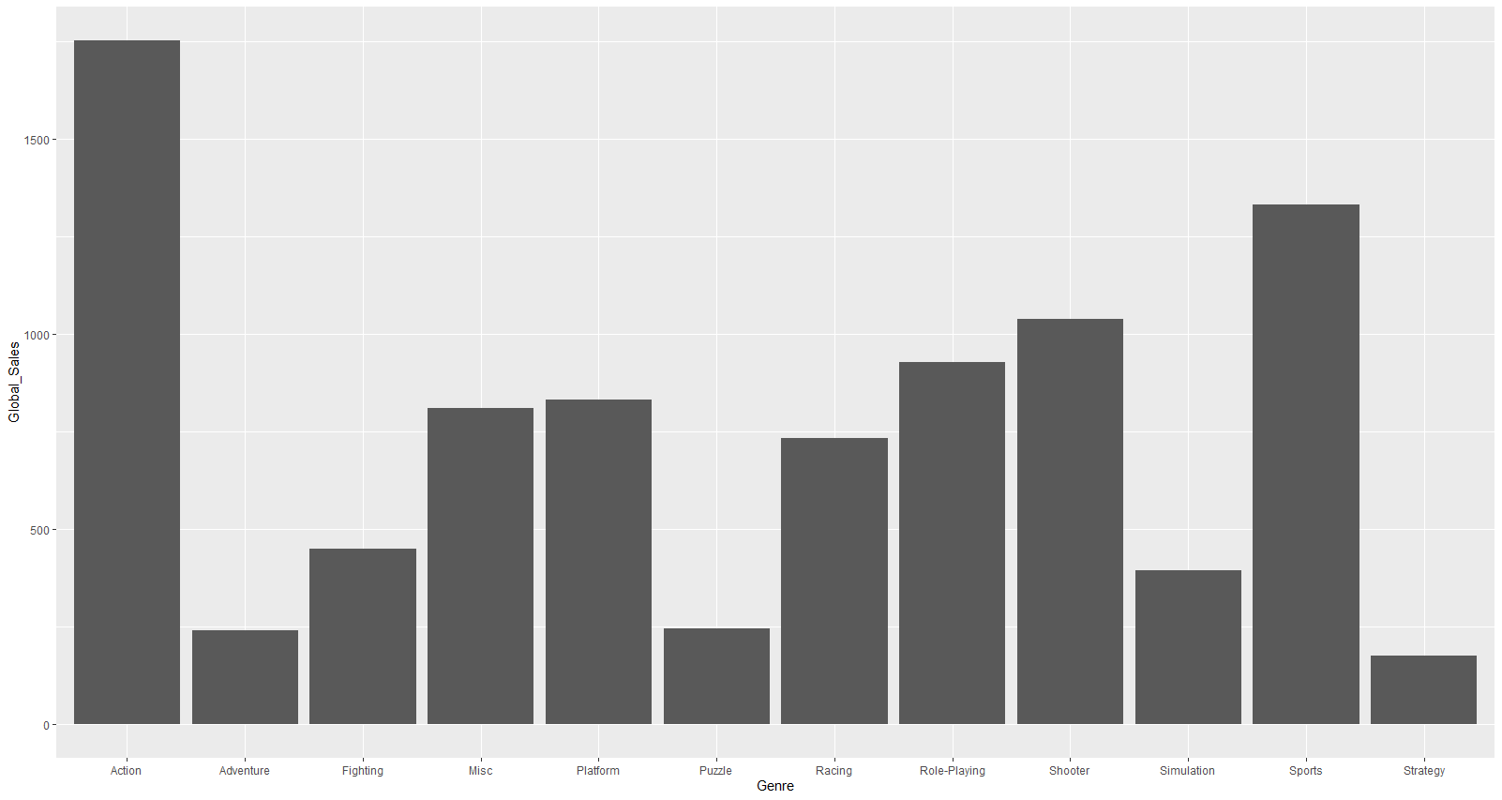
Observing the Trends of Video Game Sales
Noah Larson, Noah Geiger, Chris Jenkins, Patrick Adcox; Advisor: William Eberle
Introduction
Video games are a relatively new form of entertainment that have been growing in popularity over the years. As the market has developed, there are more genres, publishers, developers, platforms, and games than before. In this project, we aim to look at the qualities of these games that lead to the best sales so we can determine the recipe for a good game. This information can help developers figure out what might be best for their next project if they want to make a successful game.
The next observation of note is the difference between average sales of genres and total sales by genre. The average sales of genre were shown to be mostly equivalent to each other with a few peaks and lows but none to an extreme degree. Specific outliers of note is that Nintendo sales had extremely high averages across the board. On the opposite side of the board Adventure games had some of the lowest total and average sales while Sports and Shooters had the most consistent sales when considering both total and average sales.
Conclusion
The preliminary results we have obtained so far points us in a direction of what a successful game consists of. However, we will continue to explore this dataset to find more conclusions based on publishers and platforms. We have attempted to clean the dataset; however, we have had limited success on that end. Going forward, our group will be working with the data to find more insights on how a game can be described as sucessful.
Number of Average Global Sales (in millions) by Genre
Methods Explored and Planned to Explore
Data Cleaning
Plot total and average of global sales over the years.
Plot total and average of global sales and genre.
Plot total and average of global sales and platform.
Examine which genres are more popular in different regions.
Examine which publishers are most successful.
Discussion of results
The most likely cause of the inverse between total sales by year and average sales by year referred to in the previous section, is due to over saturation in the market caused by gaming's increased popularity. As the internet became more commonplace so did things like gaming resulting in the growth of total sales because the demand(games being made) increased with the supply(games wanted) resulting in more games being purchased. However; the average would decrease due to the increase of “failures” in the gaming industry. Which makes sense because the more options available to someone will result in specific options, in this case games, being left out and resulting in being a failure. This logic also explains why there is an early spike in the average sales because of extremely popular games such as Pokemon and Mario inflating the average. We can see this in our data set as these games have some of the highest global sales. This also explains why Nintendo has such a high average due to their quality sales over quantity. On the topic of quality over quantity, it is shown that some genres that have lower totals sales than the other high total selling genres still have as good, if not better, average sales. For example, Action has the highest total sales by a large margin but has an average that is placed in the middle of the genres when ranked. While on the other hand a genre like Puzzle has a very low total sales but has a better average than the Action genre. The important genres to look to determine success are the ones that have high average and total sales. These genres of note are Sports, Shooters, Platform, and Role Playing. Based on the statistics we have gathered if you wanted to make a successful game you would want to make it one of these genres. You would also want to make it unique in some way to combat the other issue stated previously, that being the over saturation of the market.
References
GregorySmith, “Video Game Sales,” Kaggle, 26-Oct-2016. [Online]. Available: https://www.kaggle.com/gregorut/videogamesales. [Accessed: 22-Feb-2021].
“Search all R packages on CRAN and Bioconductor,” RDocumentation. [Online]. Available: https://www.rdocumentation.org/. [Accessed: 15-Mar-2021].
Number of Total Global Sales (in millions) by Year
Tools Used
We have used R Studio for the manipulation of the data and to obtain the models based on that data. We will continue to use R Studio in further analysis.
Microsoft Office has been used to create this poster and will be used to create our final report.
Discord is our primary application to discuss this project and work together on it.
Number of Average Global Sales (in Millions) by Year
Results
Through observing the data there have been a few notable results. The first being an inverse growth between total sales by and average sales by year. Average sales had an early peak and then decreased as the years went on. While total sales had a gradual increase with a peak around the 2010’s.
Number of Total Global Sales (in millions) by Genre
Aknowledgements: Tennessee Tech University, Kaggle

